Slide 1
Animal Detection Based on mask-RCNN and COCOdataset
An Hoang
Keita Saito
Dept, Computer Science
Troy University
Notes:
I’m gonna talk about deep learning in biomedcal image analysis

Slide 2
The Table of Content
● What is mask-RCNN?
・overview
・architecture
・the concept of RoI
● Experiment
・Comparison between our method(mask-RCNN) and other method
(Haar algorithm with OpenCV)
・Demonstration
● Simulation Result
● Summary
・Future Plan

Slide 3

What is
Mask RCNN?

Slide 4
Introduction of mask-RCNN
・a deep neural network aimed to solve instance
segmentation problem in machine learning or
computer vision.
・can separate different object in an image or a video.
If you give it a image, it gives you the object bounding
boxes, classes and masks.
Notes:
In our life, machine learning is used everywehere. Some Chinese character is very difficult to type,
Anomaly detection: the identification of rare items, events or observations which raise suspicions by differing significantly from the majority of the data.[
検索結果をテーマごとに表示する: grouping user based on their interest
Display search results by specific user theme

Slide 5
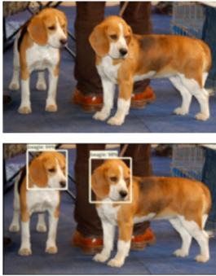
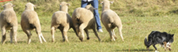

Introduction of mask-RCNN (cont)
・approach to Instance Segmentation
・It can do the following things:
1.object detection
2.Semantic Segmentation
Therefore;
Object Detection + Semantic Segmentation = Instance Segmentation
Object detection based on faster-RCNN
2. Semantic segmentation based on
FCN(fully convolutional network)
Notes:
Semantic segmentation describes the process of associating each pixel of an image with a class label, (such as flower, person, road, sky, ocean, or car).

Slide 6
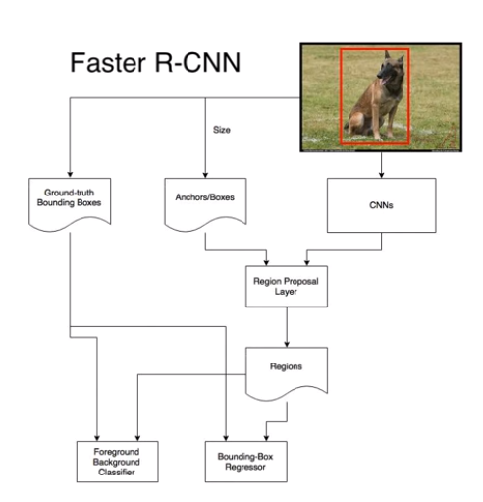
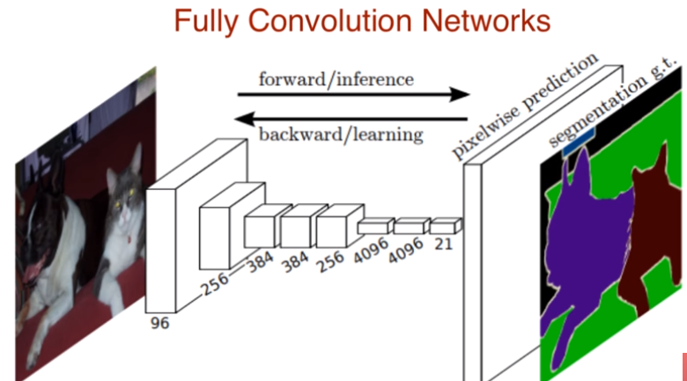
Explanation of Faster-RCNN and FCN
Faster R-CNN uses a CNN feature extractor to extract image features. And then use a CNN region proposal network to create region of interests (RoIs).
Fully convolutional networks can efficiently learn to make dense per pixel tasks like semantic segmentation

Slide 7
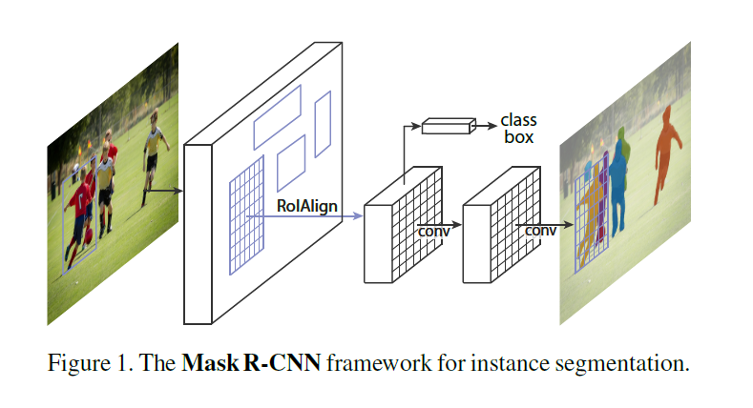
Mask-RCNN Architecture
Fully Convolutional network
Faster-RCNN
Adding a branch for predicting segmentation masks on each Region of Interest, in parallel with the existing branch for classification and boundin gbox regression.
To fix the misallignment , RoIAlign
( quantization-free layer) is used. It preserves exact spatial locations
Faster-RCNN + FCN = Mask-RCNN

Slide 8
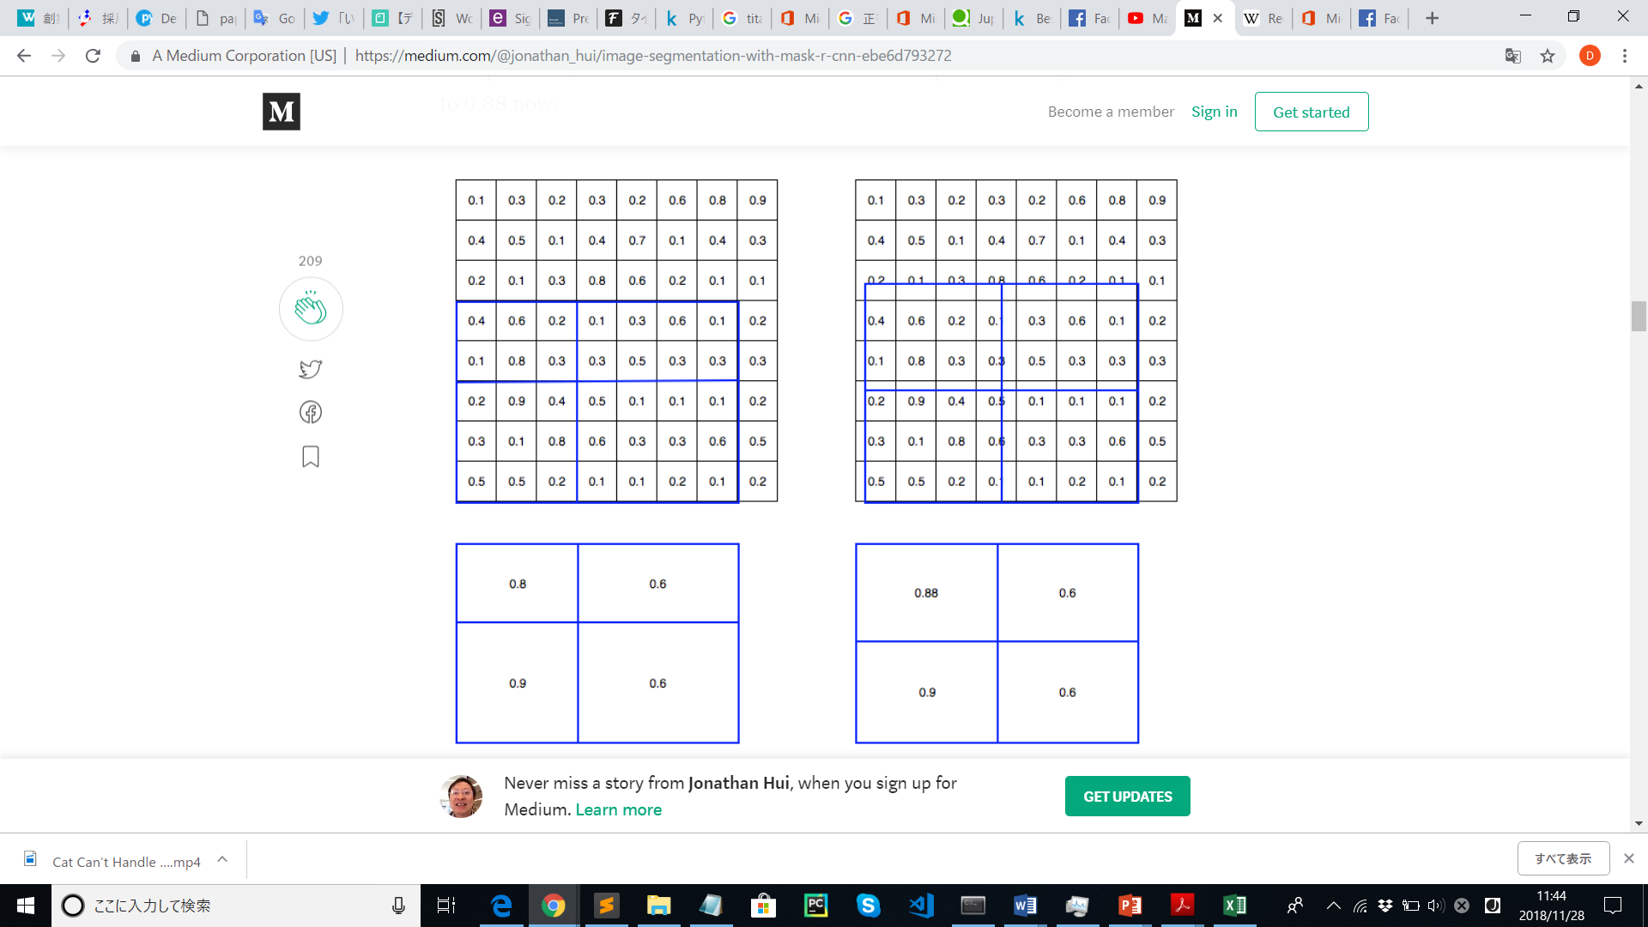
ROI(Region of Interest)
・ROI are samples within a dataset identified for a particular purpose.
In ROI, the warping (the process of digitally manipulating an image such that any shapes have been significantly distorted) is digitalized (the below left) as well as the warping (the below right): the cell boundaries of the target feature map are forced to realign with the boundary of the input feature maps. Therefore, each target cells may not be in the same size.
Notes:
Digitlized and have not same size

Slide 9
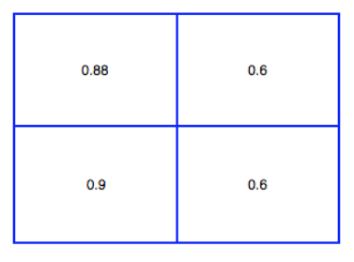

ROI(Region of Interest) Align
・Mask R-CNN uses ROI Align which does not digitalize the boundary of the cells (below left) and try to make every target cell to have the same size (below right). It also applies interpolation to calculate the feature map values within the cell better. For example, by applying interpolation (filling in frames between the key frames), the maximum feature value is changed from 0.8 to 0.88 now.
・In short, ROI Align makes significant improvements in the accuracy.
Notes:
Allow us to be not degitlizaed and each target to become more same size

Slide 10
Introduction of mask-RCNN(In detail)
・It aims for creating a framework for instance segmentation
・It builds on top of Faster-RCNN by adding a parallel
・For each Region of Interest (RoI) predicts segmentation mask using a small
FCN
・It Changes RoI pooling in Faster-RCNN to a quantization-free layer called
RoIAlign
・It Generate a binary mask for each class independently:decouples
segmentation and classification
・Result: performs better than any models in instance segmentation

Slide 11
Introduction of Haar Cascades
Object Detection using Haar feature-based cascade classifiers is an effective object detection method proposed by Paul Viola and Michael Jones in their paper, "Rapid Object Detection using a Boosted Cascade of Simple Features" in 2001. It is a machine learning based approach where a cascade function is trained from a lot of positive and negative images. It is then used to detect objects in other images.
OpenCV comes with a trainer as well as detector. If you want to train your own classifier for any object like car, planes etc. you can use OpenCV to create one. Its full details are given here: Cascade Classifier Training.

Slide 12
Data Set
・use COCOdataset
- COCO is a large-scale object detection, segmentation, and captioning dataset
provided by Microsoft
-Object segmentation Recognition in context Superpixel stuff segmentation
330K images (>200K labeled) 1.5 million object instances 80 object
categories 91 stuff categories 5 captions per image 250,000 people with
keypoints

Slide 13
Comparison between our algorithm and others
・we used the method of Haarcascades algorithm based on OpenCV to compare with our method.
・This Haar algorithm is aimed for detecting objects in images, regardless of their location and scale.
・Also, it originally focused on training detectors for arbitrary “objects” such as animals.
・In the OpenCV repository, especially within the haarcascades directory, we can get Haar cascade for detecting “animal(cat) face

Slide 14
Comparison between our algorithm and others (cont)
・the OpenCV’s frame doesn’t cover animal very well, and it’s only for image. Also, it can’t do image segmentation. It’s only for classification and localization
・While, our method can cover the image very accurately,

Slide 15
Innovative part
・Although former method can only detect animal image,
Mask-RCNN can detect animal’s motion
・HarrCascade algorithm must be based on RGB Conversion so
if the picture don’t have enough Red Green Blue it can’t detect.
Grayscale = (R + G + B / 3)
However, Mask-RCNN don’t have to depend on RGB conversion

Slide 16
Demonstration
・Comparison between two different method

Slide 17
Simulation Results
・We found that the accuracy of mask-RCNN method is much better than Haar Cascades algorithm with OpenCV.

Slide 18
Conclusion
・We found that Mask-RCNN’s accuracy is much higher than the other method
because Mask-RCNN can learn features with different scales, using ROIAlign
・Mask-RCNN is a framework to do the latest instance segmentation
・it generates high-quality segmentation mask
・This model does Object Detection, Instance Segmentation and can also be
extended to animal motion detection!.
・All of them are done in parallel !
・it’s simple to train, implement and only need a small overhead to Faster R-CNN

Slide 19
Future Plan
(1)We would like to improve our models to perform more animal detection using more features, so that we can detect not only basic animals such as dog and cat, but also we can detect rare animal.
(2)We would like to make app based on mask-RCNN so that we can know the animal’s name easier and quickly when we go to park or zoo or place where there are lots of animals.
Notes:
The process is completely hidden,therefore it’s very important

Slide 20
Reference
・https://medium.com/@alittlepain833/simple-understanding-of-mask-rcnn-134b5b330e95
(introduction of mask rcnn)
K.He, G.Gkioxari, P.Dollar, R.Girshick “Mask R-CNN”, Facehook AI Research (FAIR),2018
X.Wang, A.Shrivastava, A.Gupta “A-Fast-RCNN:Hard Positive Generation via Adversary for Object Detection” ,2017 IEEE Conference on Computer Vision and Pattern Recognition (CVPR),2017
J.Hosang, R.Benenson, P.Dollar “What makes for effective detection proposals?” ,arXiv:1502.05082, 2015
G.Papandreou, T.zhu, N.Kanazawa “Towards accurate multi-person pose estimation in the wild”, IEEE Conference on Computer Vision and Pattern Recognition (CVPR),2015
RA.Guler “Densepose:Dense human pose estimation in the wild”, arXiv:1802.00434,2018
M.Danish “Beef Cattle Instance Segmentation Using Mask-RCNN”, Dublin Institute of Technology, 2018
Z.Zhang, Z.He, G.Cao, W.Cao “Animal Detection From Highly Cluttered Natural Scenes Using Spatiotemporal Object Region Proposals and Verification”, IEEE Transactions on Multimedia Vol.18, Issue:10, 2016
B.Cheng, Y.Wei, H.Shi “Revisiting RCNN: On Awakening the Classification Power of Faster RCNN”, arXiv:1803.06799, 2018

Slide 21
Reference(cont)
W.Fang, Y.Ding, “A Novel Convolution Neural Network for Background Segmentation Recognition”, International Conference on Cloud Computing and Security, 2018
P.Zhuang, L.Xing, Y.Liu, “Maring animal detection and recognition with advanced deep learning models”, Shenzen Key Lab, 2017
S.Agarwal, JOD.Terrail, F.Jurie, “Recent Advances in Object Detection in the Age of Deep Convolutional Neural Networks”, arXiv:1809.03193,2018
K.Nguyen, “Relational Networks for Visual Relationship Detection in Images”, Oregon State University, 2017
M.Felsberg, “Five years after the Deep Learning revolution of computer vision: State of the art methods for online image and video analysis”, Linkoping University Electronic Press, 2017
R.Girshick, H.Donahue, T.Darrell, “Rich Feature Hierarchies for Accurate Object Detection and Semantic Segmentation”, The IEEE Conference on Computer Vision and Pattern Recognition(CVPR),2014
N.Zhang, J.Donahue, R.Girshick, “Part-based R-CNNs for fine-grained category detection”, European Conference on Computer Vision ,2014
J.Hosang, R.Benenson, P.Dollar, “What Makes for Effective Detection Proposals”, IEEE Transactions on Pattern Analysis and Machine Intelligence Vol.38, Issue:4, 2016
J.Hoffman, S.Guadarrama, “LSDA:Large scale detection through adaptation”, Advances in Neural Information Processing Systems 27, 2014

Slide 22
Reference(cont)
Z.Cao, JC.Principe, B.Ouyang, “Marine animal classification using combined CNN and hand-designed image features”, OCEANS 2015 – MTS/IEEE,2015
D.Pathak, RB.Girshick, P.Dollar, “Learning Features by Watching Objects Move.” ,The IEEE Conference on Computer Vision and Pattern Recognition(CVPR),2017
S.Agarwal, JOD Terrail, F.Jurie, “Recent Advances in Object Detection in the Age of Deep Convolutional Neural Networks”, arXiv:1809.03193, 2018
YM.Chou, CH.Chen, KH.Liu, “Stingray Detection of Aerial Images sing Augmented Training Images Generated by A Conditional Generative Model”,arXiv:1805.04262,2018
L.Wang, Y.Qiao, X.Tang, “Actionness estimation using hybrid fully convolutional networks”, The IEEE Conference on Computer Vision and Pattern Recognition (CVPR), 2016
T.Gamero, E.David “Object detection in videos using principal component pursuit and convolutional neural networks”,PUCP,2018
T.Do, A.Nguyen, I.Reid, “AffordanceNet: An End-to-End Deep Learning Approach for Object Affordance Detection”, 2018 IEEE International Conference on Robotics and Automation (ICRA)

Slide 23
Reference(cont)
S.Jin “Finding Objects in Complex Scenes”,University of Maryland ,2018
Y.Liu, W.Ouyang “Deep Learning for generic object detection: A survey”, arXiv:1809.02165, 2018
B.Singh, “Detecting Objects and Action with Deep Learning”, University of Maryland, 2018
H.Lee, H.Kwon, RM.Robinson, “Dynamic belief fusion for object detection”, 2016 IEEE Winter Conference on Applications of Computer Vision, 2016
GK.Verma, P.Gupta, “Wild Animal Detection Using Deep Convolutional Neural Network”, Proceedings of 2nd International Conference on Computer Vision & Image Processing, 2018
W.Greatwood “Visual Localisation and Individual Identification of Holstein Friesian Cattle via Deep Learning”, 2017 IEEE International Conference of Computer Vision Workshop, 2017

